Slide 1
RESTFULL WEB SERVICES

Slide 2
WHAT IS REST?
HTTP + Resource-Oriented Architecture

Slide 3
World Wide Web
The Web as defined by Tim Berners-Lee consists of three elements:
URI (Uniform Resource Identifier) - The way of uniquely identifying resources on the network.
HTML (HyperText Markup Language) - The content format of resources to be returned.
HTTP (HyperText Transfer Protocol) - The protocol used to request a resource from the network and respond to requests.
HTTP methods
All client server communication on the World Wide Web are
done using the following simple HTTP methods:
GET = "give me some info" (Retrieve)
POST = "here's some new info" (Create)
PUT = "here's some info to update” (Update)
DELETE = "delete some info" (Delete)

Slide 4
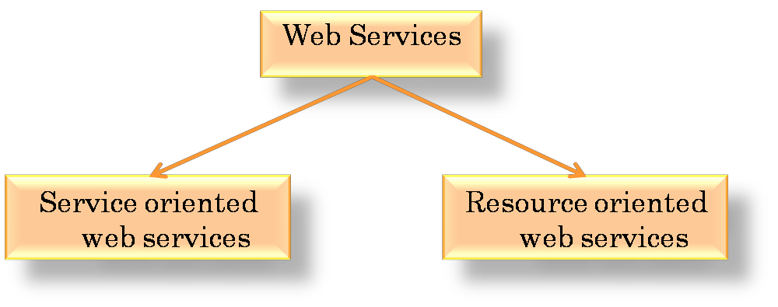
Web Services
Services (usually some combination of program and data) that are made available from a Web server for access by Web users or other Web-connected programs.
Specific business functionality exposed by a company, usually through an Internet connection, for the purpose of providing a way for another company or software program to use the service.
Types of Web Services:

Slide 5
Types of Web services
Service-Oriented Web Services
Based on “services”
One service offers multiple functionalities
“Big” Web Services
JAX-WS = JAVA-API for XML-based Web Services, mainly using
WSDL/SOAP
Resource-Oriented Web Services
Based on “resources”
Resource - any directly accessible and distinguishable distributed component available on the network.
RESTful Web Services
JAX-RS = JAVA-API for RESTful Web Services, using only HTTP

Slide 6
HTTP REQUEST
GET / HTTP/1.1
User-Agent: Mozilla Firefox Host: example.com
Accept: */*

Slide 7
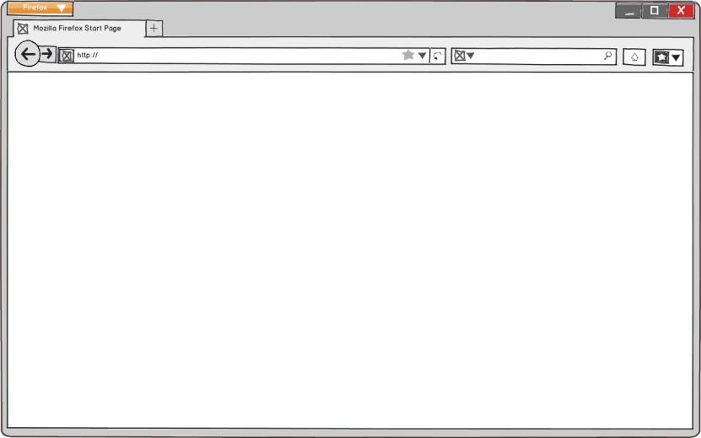


HYPERTEXT TRANSFER PROTOCOL
HTTP Response
Mozilla Firefox
example.com
Client
Server
20

Slide 8
HTTP RESPONSE
HTTP/1.1 200 OK
Content-Type: text/html Content-Length: 1270
<!doctype html>
<html>
<head>
<title>Example Domain</title>
</head>
<body> … </body>
</html>

Slide 9
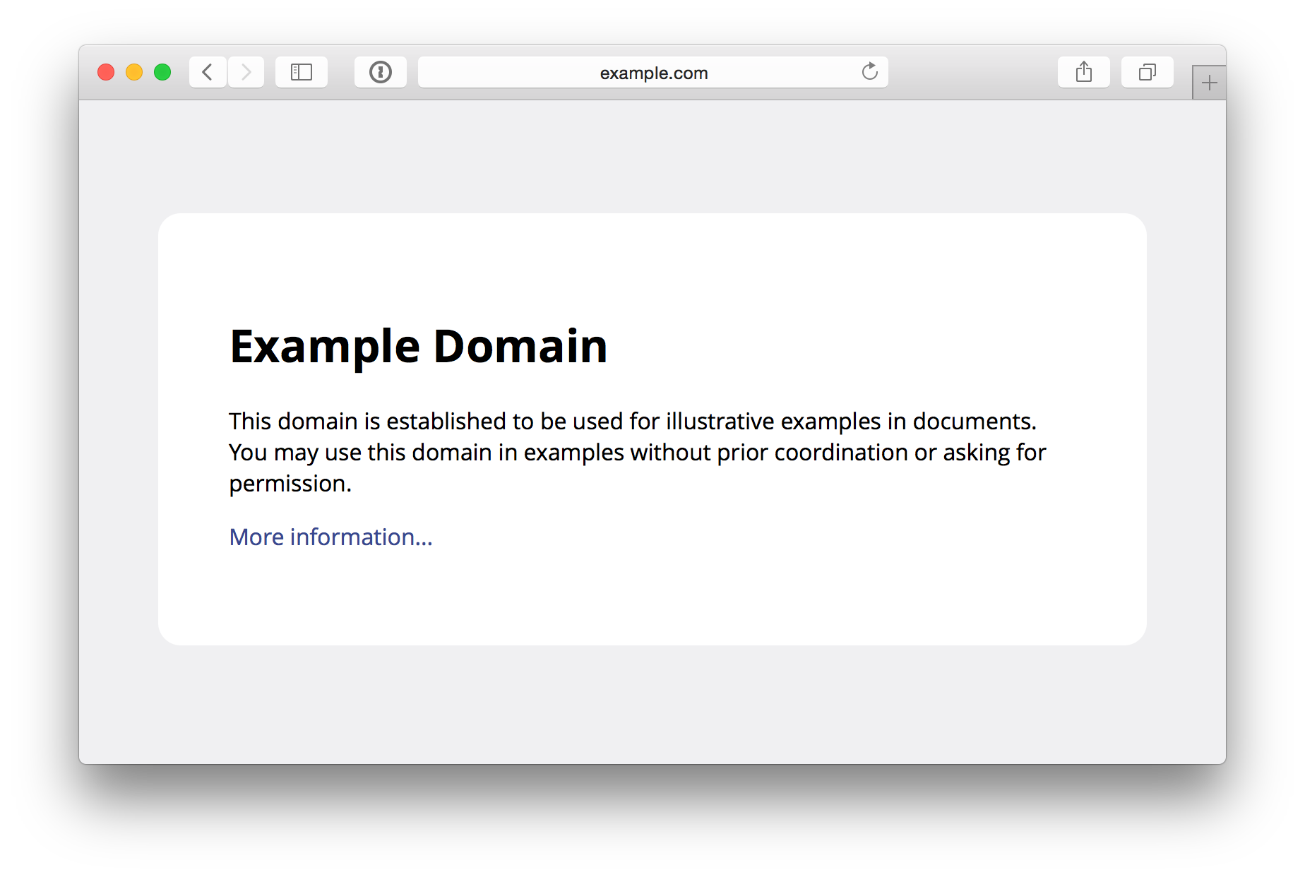

Slide 10
RESOURCES
Anything that can be identiﬁed, named, addressed or handled on the Web

Slide 11
RESOURCE NAMES
▫URN - Uniform Resource Name
▫products/54321
▫about-us
▫articles/web.html
▫posts/2015-04-13
▫podcasts/rest.mp3

Slide 12
▫URL - Uniform Resource Locator
RESOURCE LOCATORS
▫http://example.com/products/54321
▫http://example.com/about-us
▫http://example.com/articles/web.html
▫http://example.com/posts/2015-04-13
▫http://example.com/podcasts/rest.mp3

Slide 13
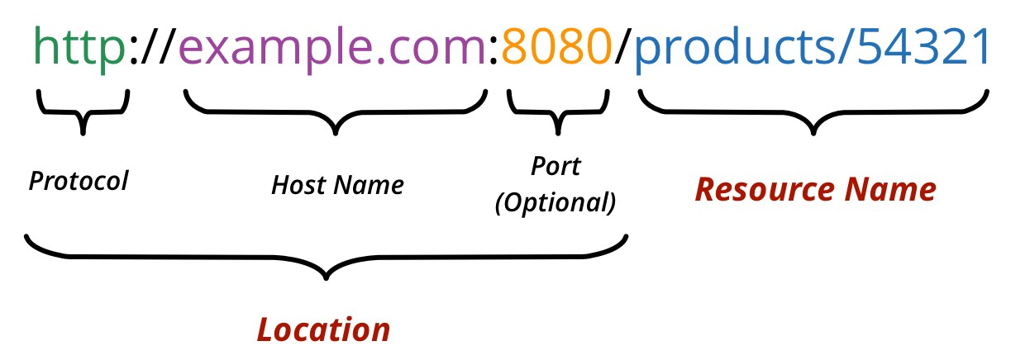
ANATOMY OF AN URL

Slide 14
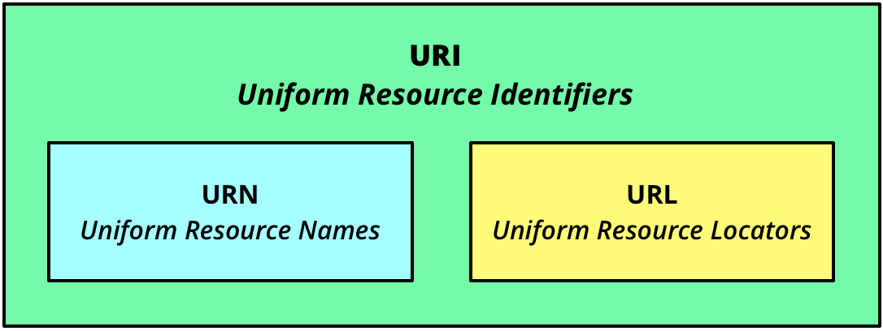
RESOURCE IDENTIFIERS
30

Slide 15
RESOURCE IDENTIFIERS
A resource only exists on the Web if it has an
identiﬁer (URI)

Slide 16
RESOURCES
HTTP can manipulate not only hypertext documents but any type of resources

Slide 17
HTTP CONTENT TYPES
▫Determine the type of the HTTP payload
▫text/html - HTML
▫text/plain - Plain Text
▫audio/mpeg3 - MP3 ﬁles
▫application/xml - XML
▫…

Slide 18
HTTP VERBS
▫GET
▫POST
▫PUT
▫DELETE
▫HEAD
▫OPTIONS

Slide 19
HTTP STATUS CODES
▫Success (2xx)
▫201 Created
▫204 No Content
▫…
▫200 OK

Slide 20
HTTP STATUS CODES
▫Client Error (4xx)
▫400 Bad Request
▫404 Not Found
▫409 Conflict
▫…

Slide 21
HTTP STATUS CODES
▫Server Error (5xx)
▫500 Internal Server Error
▫503 Server Unavailable
▫…

Slide 22
REST
REST = REpresentational State Transfer
Architectural style in which clients and servers exchange representations of resources by using a standardized interface and protocol.
Principles of REST:
Addressability (URI)
Interface Uniformity (HTTP)
Statelessness (HTTP)
Connectedness (Hypermedia)

Slide 23
REST
HTTP + Resource-Oriented Architecture
RESTful

Slide 24

EMPLOYEE RESOURCE

Slide 25
EMPLOYEE RESOURCE
▫Alice
▫Developer
▫Female
▫…

Slide 26
XML REPRESENTATION
<employee>
<name>Alice</name>
<role>Developer</role>
<gender>female</gender>
</employee>

Slide 27
JSON REPRESENTATION
{
"name": "Alice",
"role": "Developer", "gender": "female"
}

Slide 28
HTML REPRESENTATION
<h1>Alice</h1>
<dl>
<dt>Role:</dt>
<dd>Developer</dd>
<dt>Gender:</dt>
<dd>Female</dd>
</dl>

Slide 29
EMPLOYEE RESOURCE
/employees

Slide 30
EMPLOYEE RESOURCE
/employees/alice
/employees/bob
/employees/eve

Slide 31
RESOURCE OPERATIONS
▫Create
▫Read
▫Update
▫Delete
▫List

Slide 32
LIST EMPLOYEE RESOURCES
HTTP Request
GET /employees HTTP/1.1 Host: example.com Accept: application/xml
60

Slide 33
LIST EMPLOYEE RESOURCES
HTTP Response
HTTP/1.1 200 OK
Content-Type: application/xml
<employees>
<employee href="/employees/alice"/>
<employee href="/employees/bob"/>
<employee href="/employees/eve"/>
</employee>

Slide 34
READ EMPLOYEE RESOURCE
HTTP Request
GET /employees/alice HTTP/1.1 Host: example.com
Accept: application/xml

Slide 35
READ EMPLOYEE RESOURCE
HTTP Response
HTTP/1.1 200 OK
Content-Type: application/xml
<employee>
<name>Alice</name>
<role>Developer</role>
<gender>female</gender>
</employee>

Slide 36
CREATE EMPLOYEE RESOURCE
HTTP Request
POST /employees HTTP/1.1 Host: example.com
Content-Type: application/xml
<employee>
<name>John</name>
<role>QA</role>
<gender>male</gender>
</employee>

Slide 37
CREATE EMPLOYEE RESOURCE
HTTP Response
HTTP/1.1 201 Created Location: /employees/john

Slide 38
UPDATE EMPLOYEE RESOURCE
HTTP Request
PUT /employees/alice HTTP/1.1 Host: example.com
Content-Type: application/xml
<employee>
<name>Alice</name>
<role>Manager</role>
<gender>female</gender>
</employee>

Slide 39
UPDATE EMPLOYEE RESOURCE
HTTP Response
HTTP/1.1 200 OK

Slide 40
DELETE EMPLOYEE RESOURCE
HTTP Request
DELETE /employees/alice HTTP/1.1 Host: example.com

Slide 41
DELETE EMPLOYEE RESOURCE
HTTP Response
HTTP/1.1 204 No Content

Slide 42
RESOURCE-ORIENTED ARCHITECTURE
Addressability
Statelessness
Connectedness
Uniform Interface
70

Slide 43
ADDRESSABILITY
Every interesting piece of information the server can provide should be exposed as a resource, and given its own URI

Slide 44
ADDRESSABILITY
http://example.com/employees/alice

Slide 45
STATELESSNESS
Every HTTP request should happen in
complete isolation

Slide 46
STATELESSNESS
http://google.com/search?q=jellyfish

Slide 47
STATELESSNESS
http://google.com/search? q=jellyfish&start=10

Slide 48
CONNECTEDNESS
Documents should contain not just data, but links to other resources

Slide 49
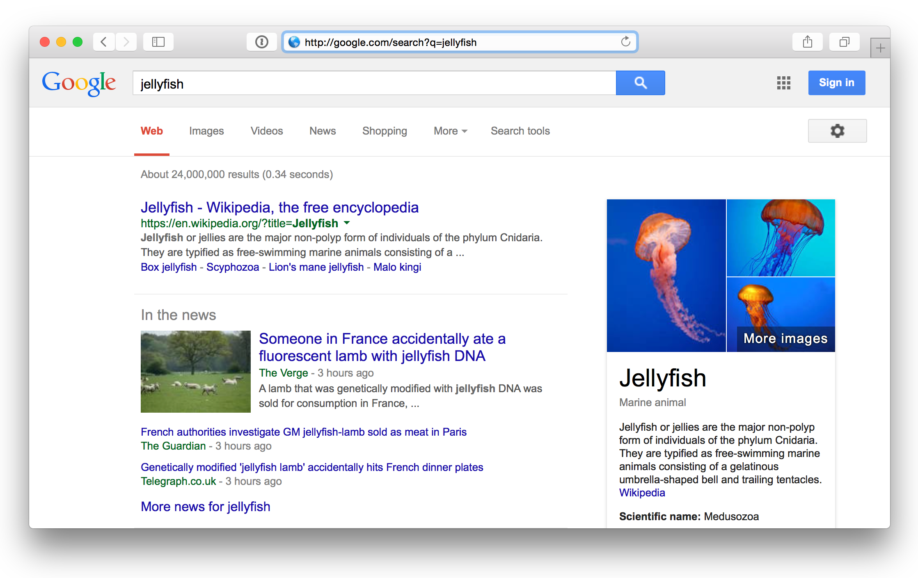
CONNECTEDNESS
80

Slide 50
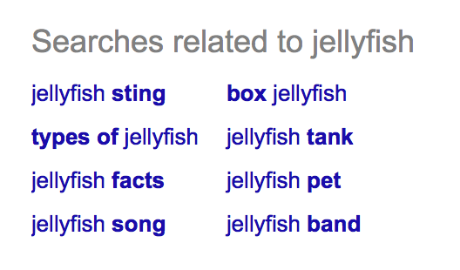
CONNECTEDNESS

Slide 51
CONNECTEDNESS
{
"employees": [ "/employees/alice", "/employees/bob", "/employees/eve",
...
]
"next_page":
"/employees?start=10",
"create_employee":
"/employees"
}

Slide 52
UNIFORM INTERFACE
▫Create:
POST /employees GET /employees/alice
▫Read:
▫Update:
PUT /employees/alice DELETE /employees/alice
▫Delete:
▫List:
GET /employees

Slide 53
UNIFORM INTERFACE
▫Create:
POST /resource
GET /resource/{name}
▫Read:
▫Update:
PUT /resource/{name} DELETE /resource/{name}
▫Delete:
▫List:
GET /resource

Slide 54
SAFETY
GET and HEAD never change the resource
state

Slide 55
INDEMPOTENCE
GET, PUT and DELETE are indempotent

